Slide 1
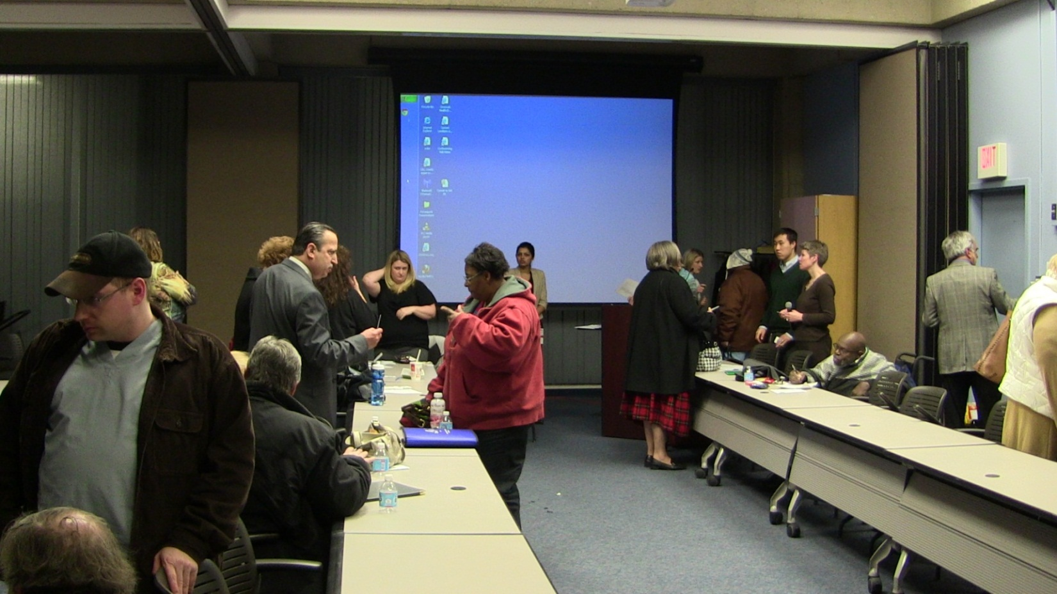
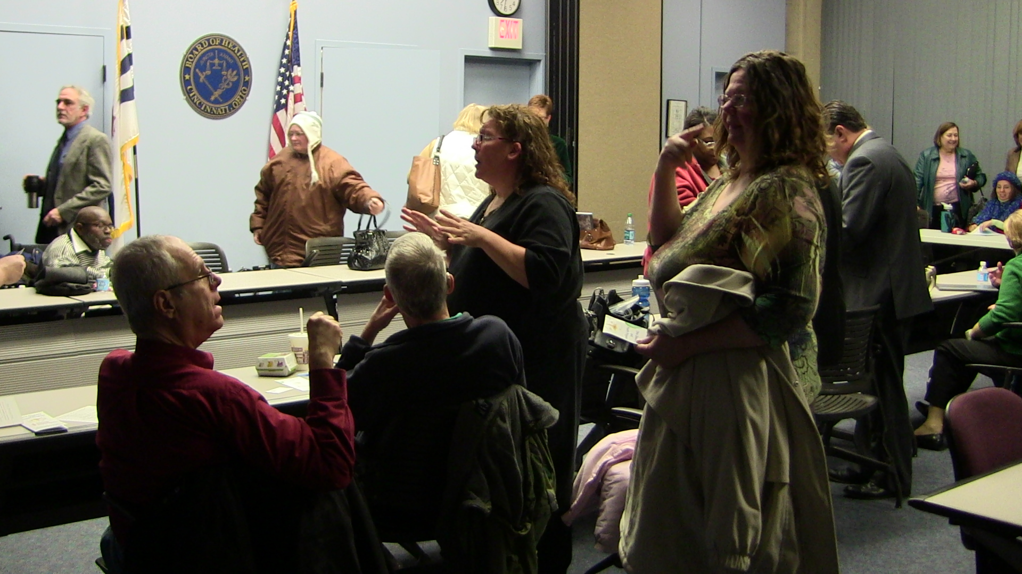
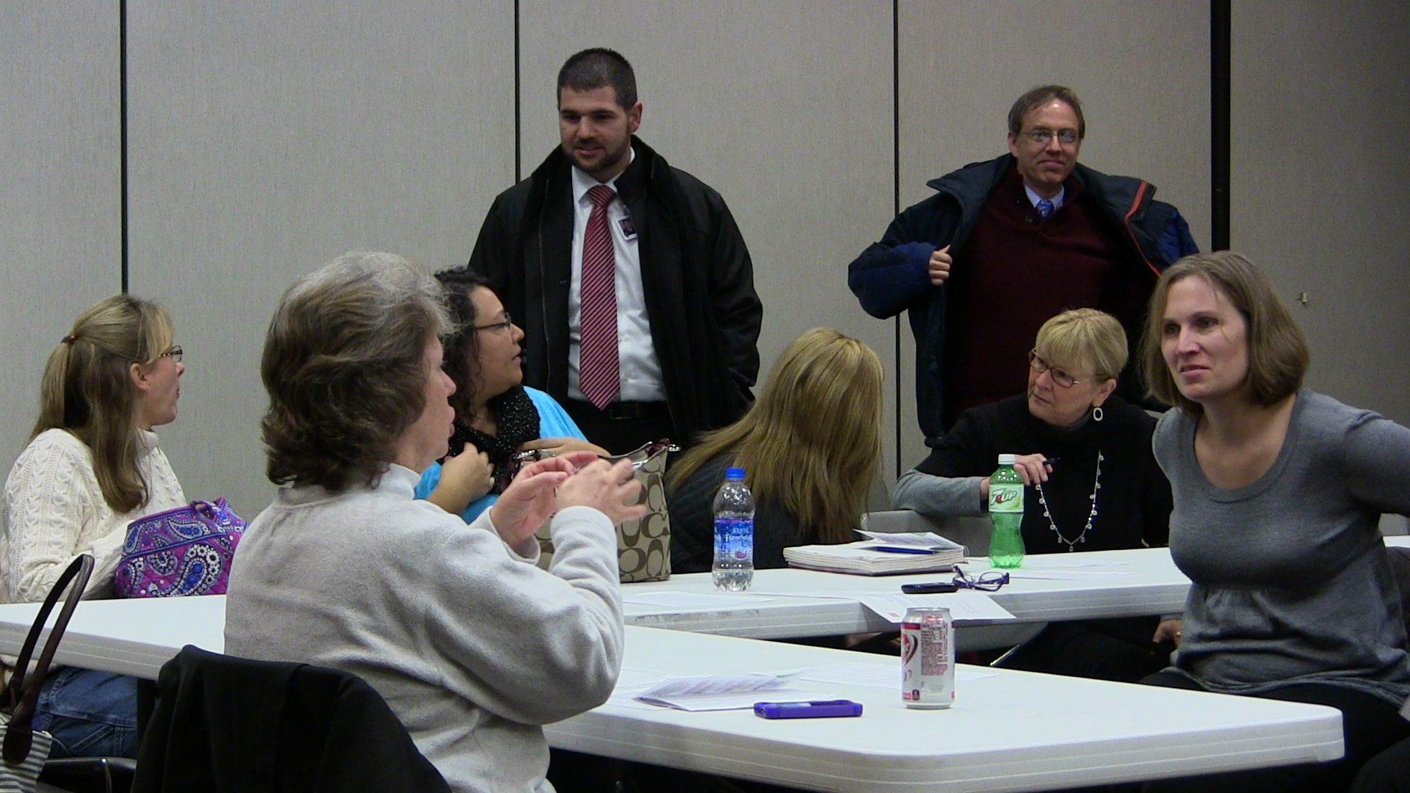
Individuals with Disabilities’ Experiences with Access to Health Care, Health Promotion, and Emergency Preparedness: Ohio Open Forum Results
Erica Coleman, MS; Anureet Benipal, MPH; Susan Havercamp, PhD; Ilka Riddle, PhD; Yiping Yang, MPH
Ohio Disability and Health Program (ODHP)
Nisonger Center, UCEDD l University of Cincinnati UCEDD
ODHP Forums Overview
The ODHP held open forums in Stow, Chillicothe, and Cincinnati in early 2013 to receive input from individuals with disabilities and family members/caregivers on three specific areas: Access to Care, Health Promotion, and Emergency Preparedness. This is part of a statewide needs assessment that consists of review and analysis of various state-based data sets and focus group sessions that capture qualitative data.
Topics Discussed
The Ohio Disability and Health Program
The Ohio Disability and Health Program (ODHP) is a Centers for Disease Control and Prevention (CDC) three-year (2012-2015) funded program with goals to promote health, improve emergency preparedness, and increase access to care for Ohioans with disabilities.
The ODHP is a partnership between the Nisonger Center at The Ohio State University, the Ohio Department of Health, the University of Cincinnati University Center for Excellence in Developmental Disabilities (UC UCEDD), and the Ohio Colleges of Medicine Government Resource Center.
Ohio is one of 18 states that receive funding for this statewide capacity-building project to improve the health of people with disabilities.
Healthcare Access
Forum participants were asked about their experiences accessing healthcare facilities for someone with a disability and their experiences with healthcare providers
Health Promotion
Forum participants were asked to discuss their level of involvement in public health/health promotion programs.
Emergency Preparedness
Forum participants were asked about how they typically respond to emergencies and if they have an emergency plan.
Forum Participants
A total of 60 participants attended the open forums
The majority (67%) of the participants ranged in age from 35-64 years, and the group consisted primarily of females (73%)
About 65% of forum participants reported either having a disability or being a caregiver of someone with a disability. Of the total group, 30% reported having one or more disabilities.
Next
Steps
Participant Responses
The information collected from the Ohio Open Forums , in combination with various data reports and an online survey was used to create the Disability and Health in Ohio Public Health Needs Assessment. This report is currently being used to inform our project activities for the next two years.
Healthcare Access
Health Promotion
Emergency Preparedness
“We are often denied accessibility to interpreters when we go to the doctor’s office. I work with several clients who when we went in, the interpreter wasn’t available because they either forgot to call, or didn’t follow up, or the patient didn’t request it.”
“My mother has Cerebral Palsy and wears leg braces. She weighed about 80 pounds at her last visit. She’s had progressive weight loss. The nurses look at her and [say] ‘It’s a hassle to take your braces off, don’t worry about it, just step on the scale’.”
“My son is a person with autism and doesn’t read at all to my knowledge. Doctors just give him a bunch of brochures and say ‘here, have your mom read these to you’ - It would be great to have more information that is less print oriented and written at an education level that is lower or simpler. We are not all geniuses.”
“Many times health promotion comes with values attached for people with disabilities. They give their opinions and values of what is a bad outcome for them [health care providers] based on them [health care professionals]. Something about people with disabilities opens the door to give their opinions and judgment.”
“In public schools, most public schools say they have emergency preparedness in place for kids with disabilities, but many of them don’t have very realistic plans. One building has several floors and one elevator but it is an emergency and their plan is to carry people in wheelchairs, in their wheelchairs down from the third floor in an emergency…. No, they haven’t practiced it.”
Contact:
Erica Coleman, MS
513-803-4399
Erica.Coleman@cchmc.org
ODHP Website: http://nisonger.osu.edu/odhp
/OhioDisabilityandHealthProgram
@OhioDHP
This project is funded by CDC Cooperative Agreement # 5U59DD000931-02
Notes:
Any cool visual the states are doing?
Bottoms or widgets

